Slide 1
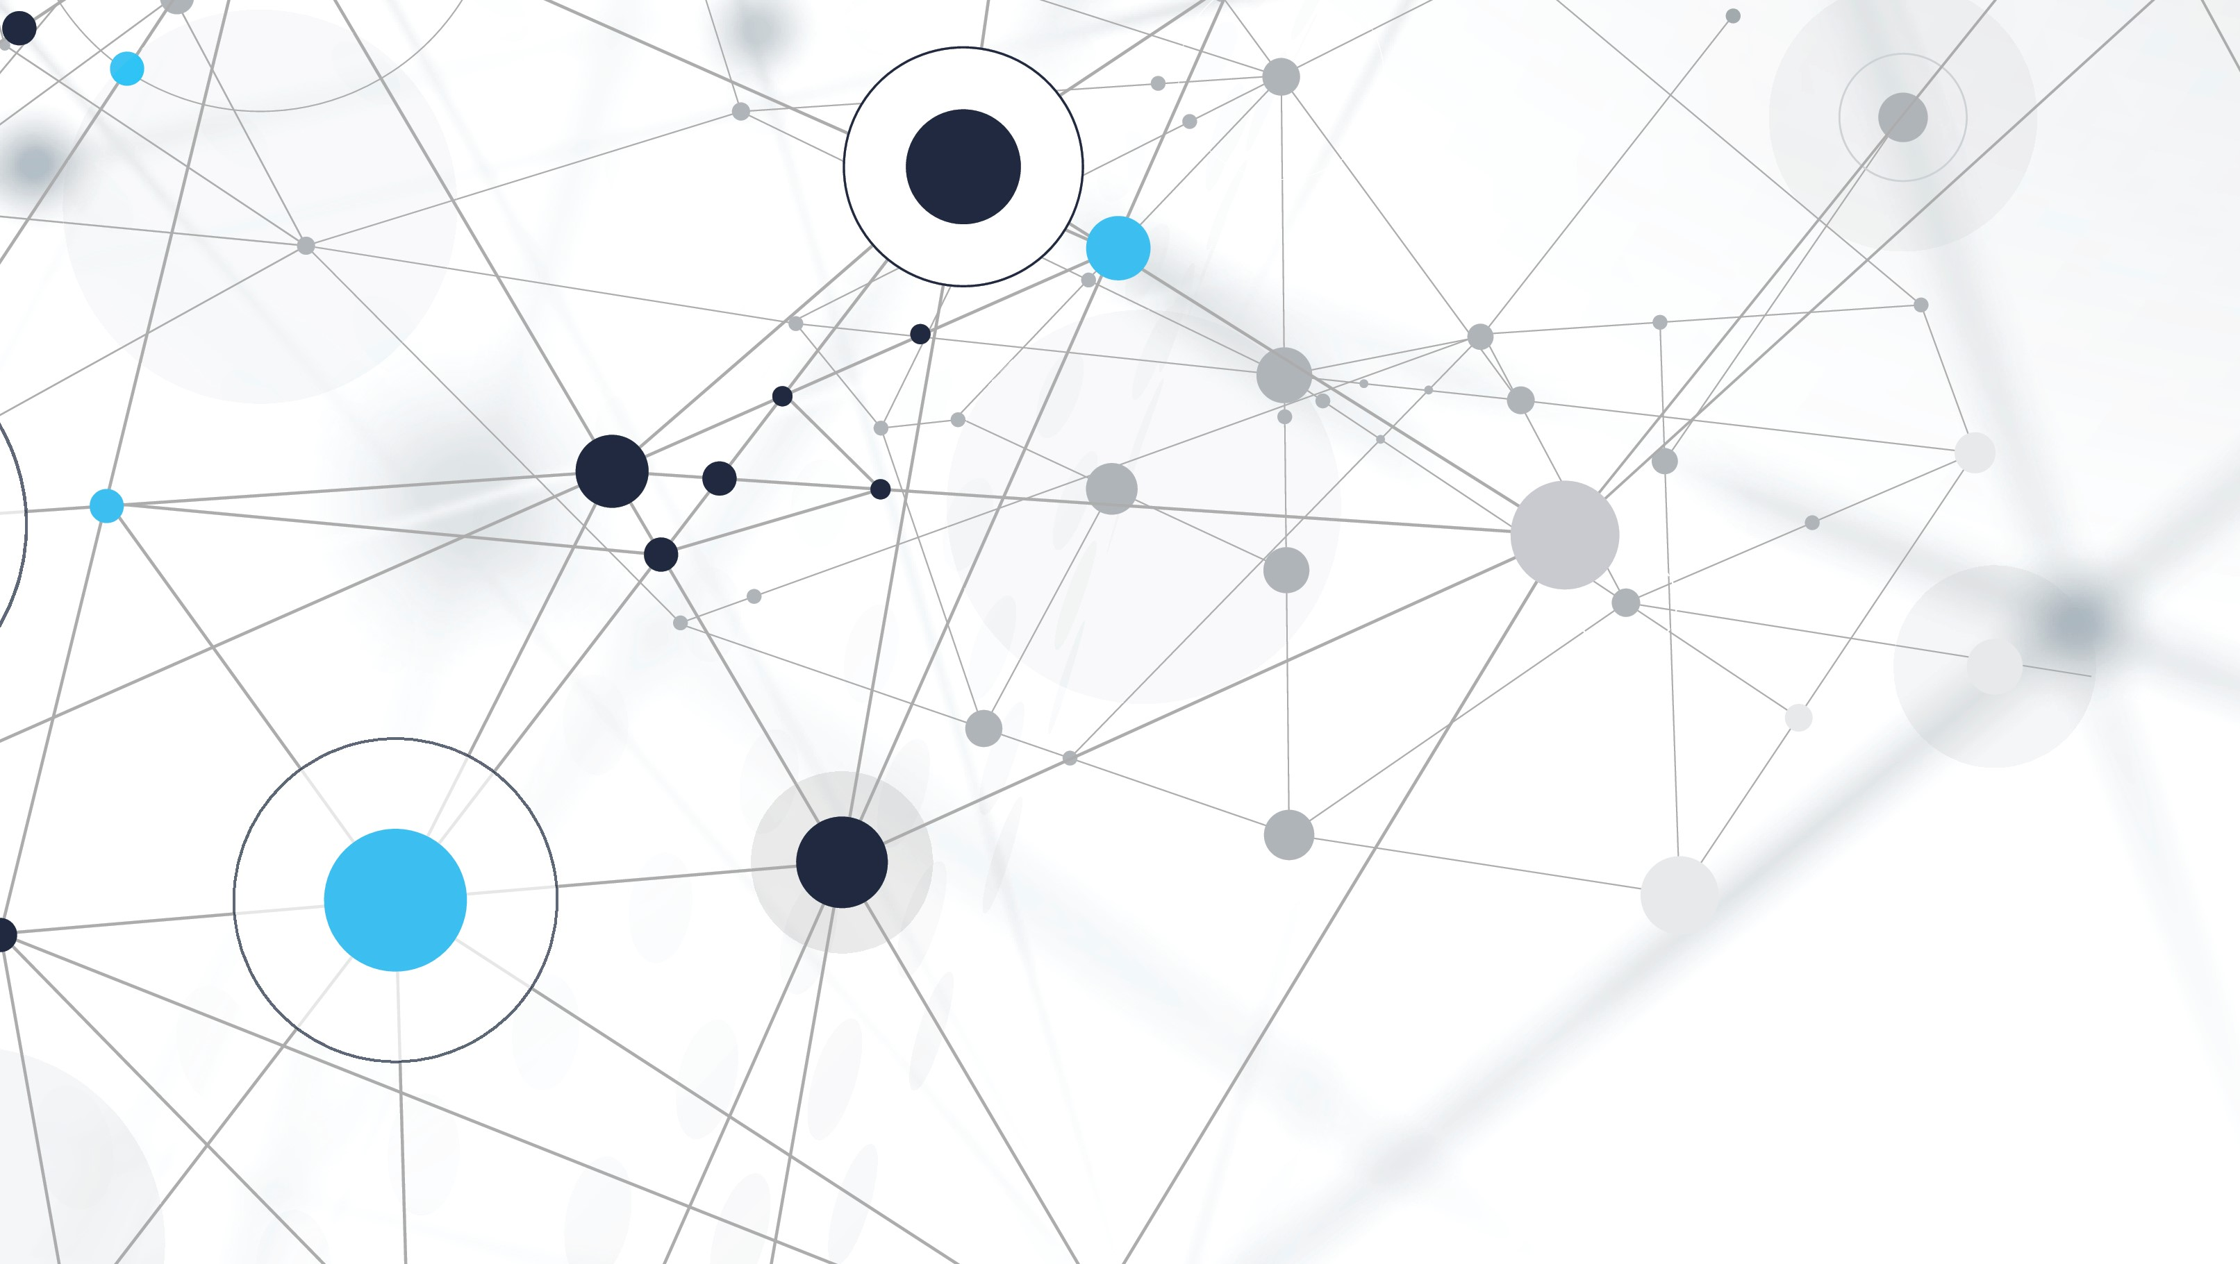
A Secure and Decentralized Framework for Medical Image Sharing
Maha Alrasheed & Arun George Zachariah

Slide 2
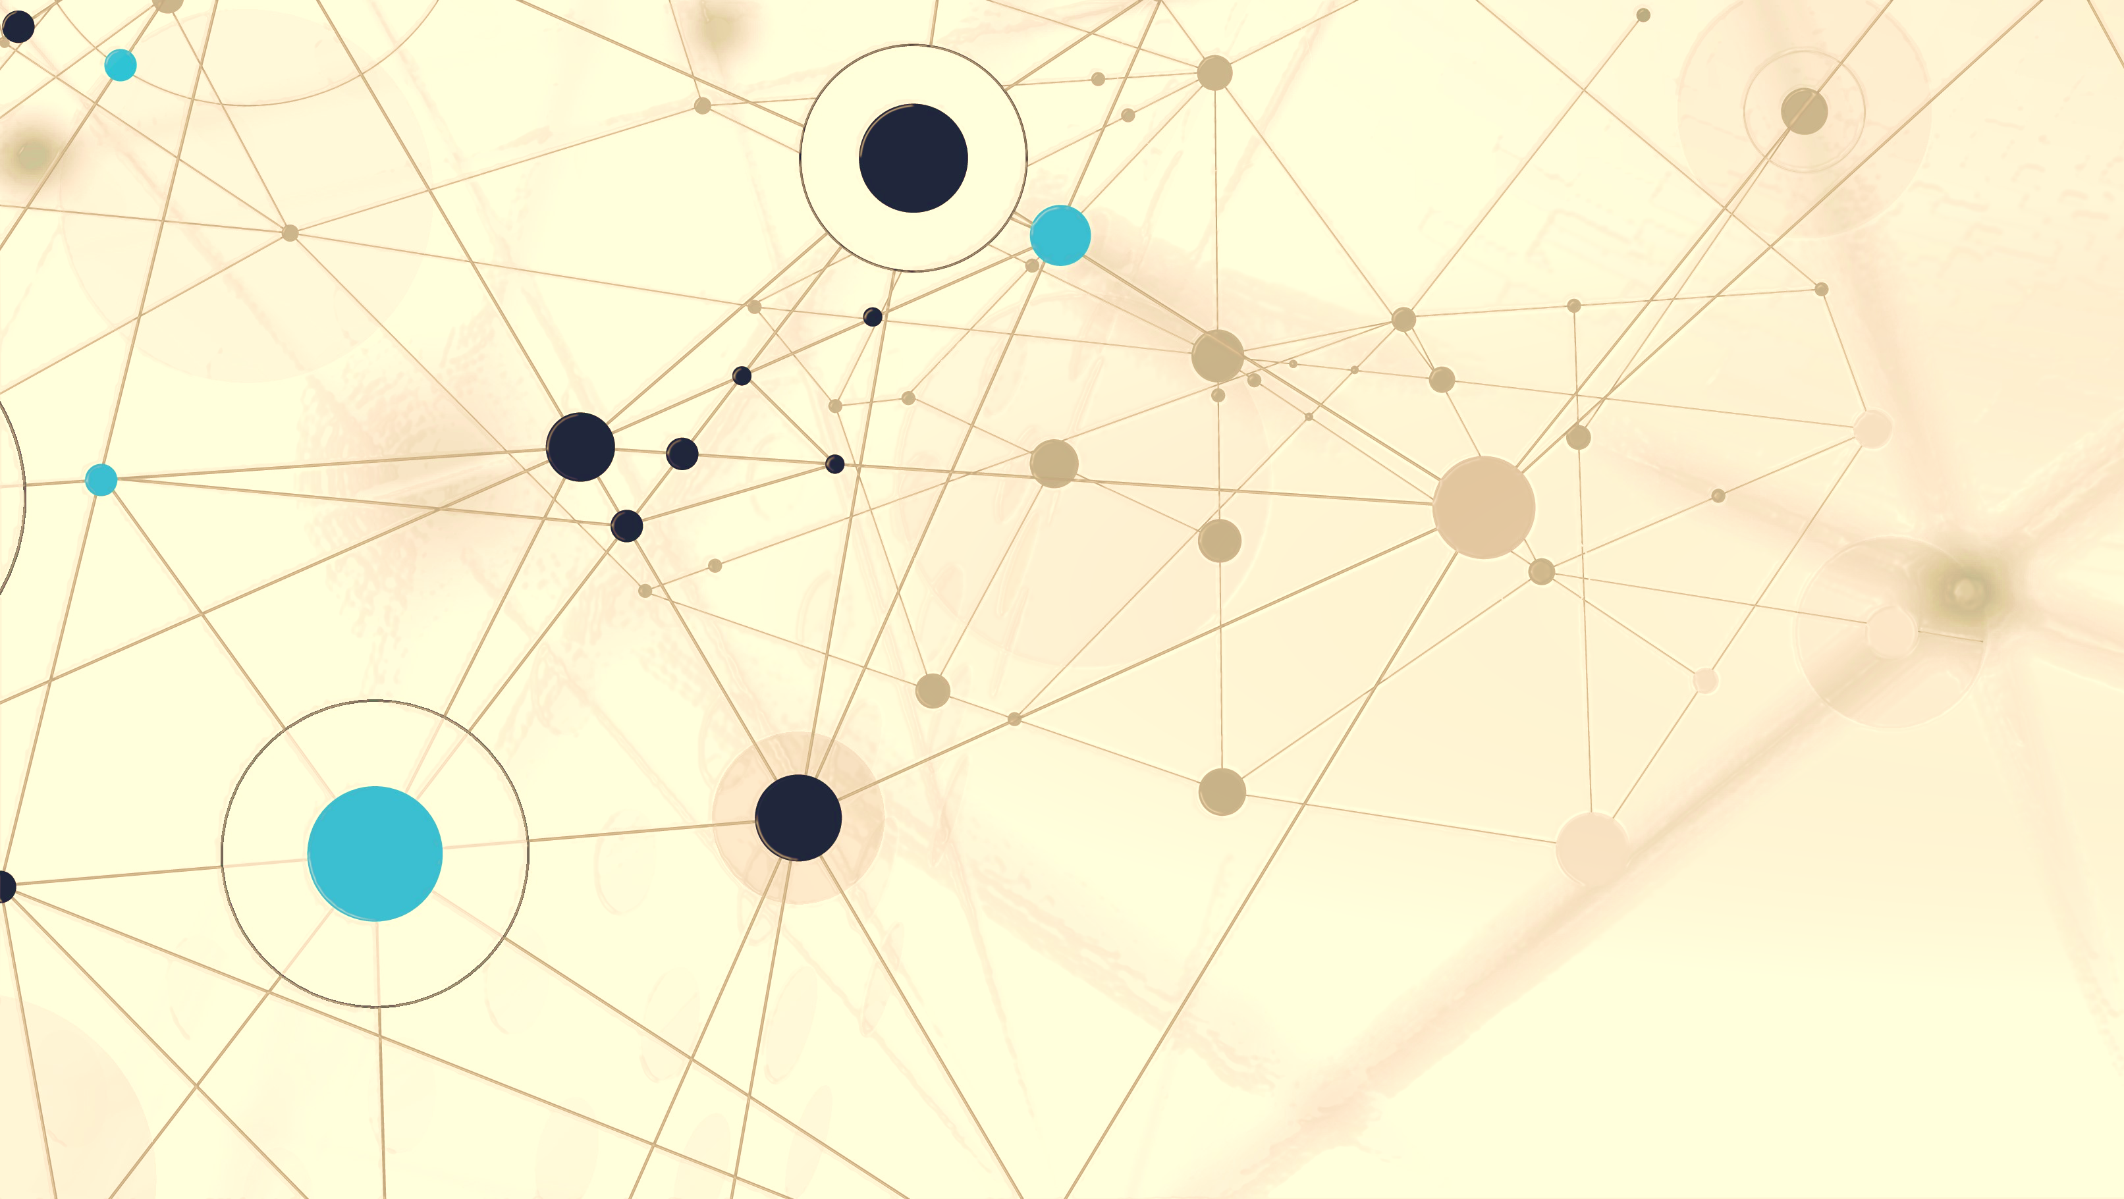
Motivation:
- Healthcare data breaches are happening at an alarming rate.
- Stringent regulation guidelines.
- Highly scalable private clouds requires a large investment
- Cross-domain access control and secure sharing of medical data at scale still is challenge.
- Private medical data banks prevent collaborative medical research.
- Blockchain will disrupt data storage!

Slide 3
Data to use :
Matric Data:
HealthData.gov
MHEALTH Dataset Data Set
The Human Mortality Database
Image Datasets:
The Cancer Imaging Archive (TCIA)
CAMELYON Dataset
The Open Access Series of Imaging Studies (OASIS)

Slide 4
Common Techniques :
PACS (Picture archiving and communication system)
Cloud PACS
Vendor Neutral Archives (VNAs)
Limitation: Security
Deeplearning Approaches for Image reconstruction
Deliberate noising of data to enhance security.
Limitation: Accuracy and Reproducibility

Slide 5
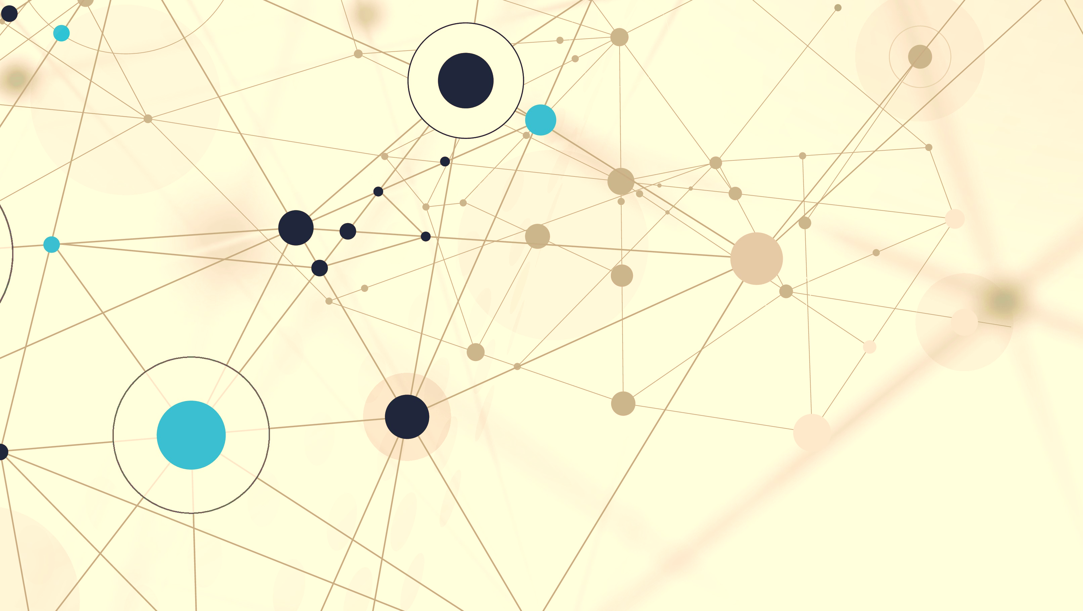
Personal Motivation:
Application of AI in the area of Precision Medicine has the potential to revolutionize the field. A major deterrent is the availability of Open/Private datasets.
We are interested in the technology behind a Blockchain.
While Blockchain has been widely used for recording transactions, its usage for data storage is a widely under explored area

Slide 6
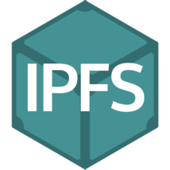
IPFS :
InterPlanetary File System (IPFS) is a protocol and network designed to create a content-addressable, peer-to-peer method of storing and sharing hypermedia in a distributed file system.
Points to Note:
It is a protocol.
Uses a peer-to-peer networking approach.
Utilises the concept of a distributed file system.
Content is addressed using a hash.
It can be a private network as well.

Slide 7
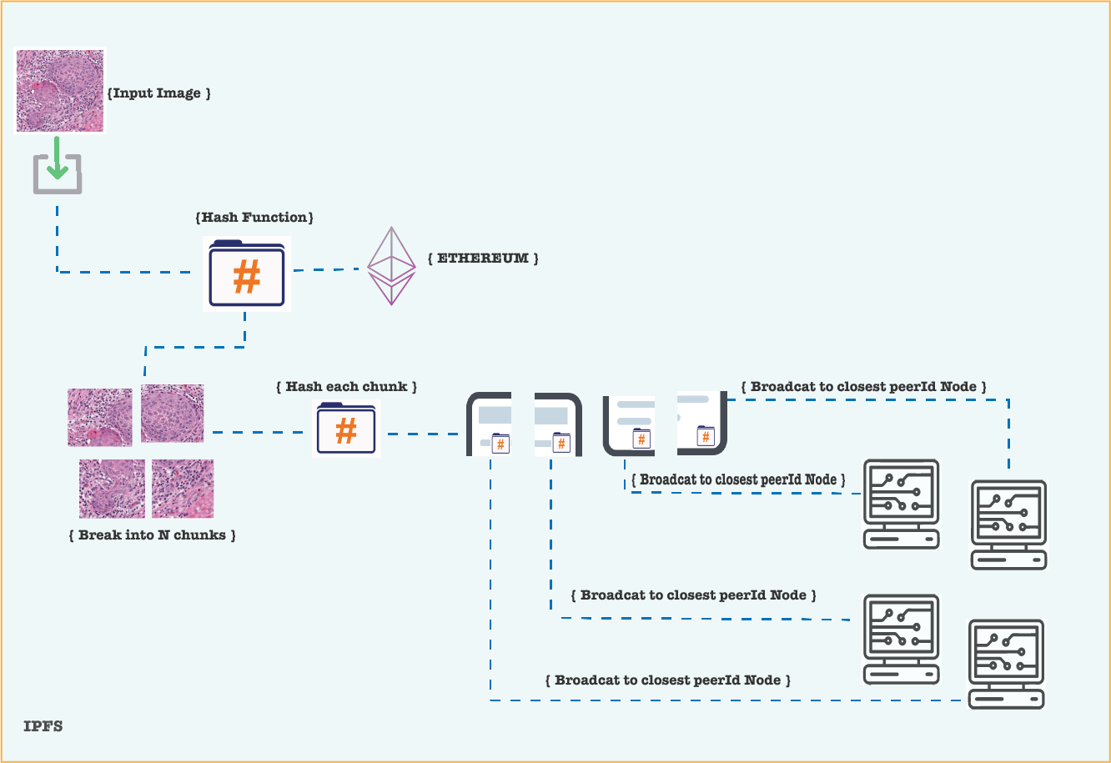
How IPFS Works:

Slide 8

Ethereum:
Launched in 2015, Ethereum is the world’s leading programmable blockchain.
It is an open source, public, blockchain-based distributed computing platform featuring smart contract (scripting) functionality.
Provides a decentralized virtual machine called the Ethereum Virtual Machine.

Slide 9
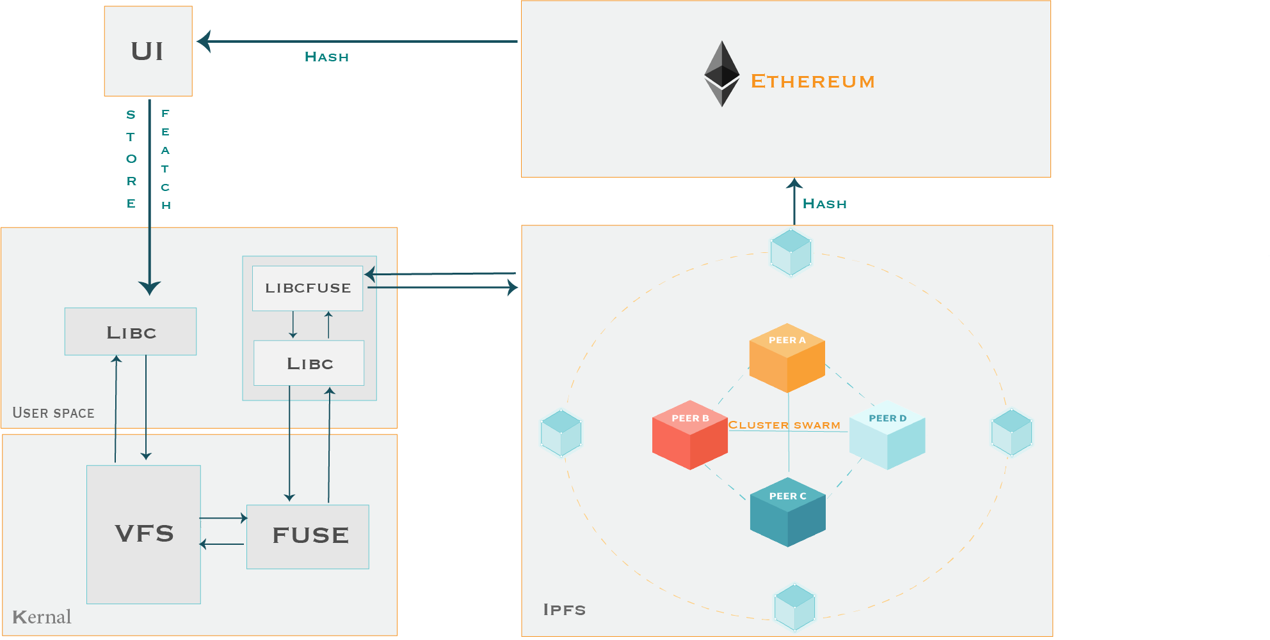
System Architecture :

Slide 10
System Architecture :
- Platform:
InterPlanetary File System
Ethereum
Linux
- Tools
MetaMask
Truffle
Web3
libfuse
go-ipfs
- Languages
C
C++
Bash
Solidity
Javascript

Slide 11
Challenges :
Latency and Speed.
Private/Public Network.
Nodes adding and leaving the network.
The IPFS framework is still in its budding state.

Slide 12
References :
[1] H. Jin, Y. Luo, P. Li, and J. Mathew, “A review of secure and privacy- preserving medical data sharing,” IEEE Access, vol. 7, pp. 61656– 61 669, 2019.
[2] J. Liu, X. Li, L. Ye, H. Zhang, X. Du, and M. Guizani, “Bpds: A blockchain based privacy-preserving data sharing for electronic medical records,” in 2018 IEEE Global Communications Conference (GLOBECOM), 2018, pp. 1–6.
[3] Ethereum Platform. [Online]. https://github.com/ethereum/go-ethereum/releases.
[4] IPFS [Online]. https://docs.ipfs.io
[5] libfuse [Online]. https://github.com/libfuse/libfuse

Slide 13
Thank you ..

